Slide 1
Muiltple Object Tracking using RNNs
Khizer Amin

Slide 2
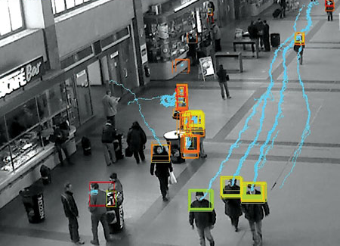
Introduction
Why tracking?
Association: keep the object identity across frames
SpeedUp: Local prediction (fast for intermediate frames)
Why RNN/LSTMs
Natural language processing
ANNs can‘t deal with the temporal or sequential data.
Memory (They retain context by having memory)
Applications
Video surveillance
Traffic management
Medical imaging
Notes:
Hello everyone, my name is Khizer Amin. Rightnow I‘’m doing my masters thesis at OSRAM for my Masters in AI degree.
My thesis title is MO3D position tracking using RNN. The focus of the thesis is on Tracking: which means objects ,i.e. obj association which is basically connecting 2 objects BB’s over time so that we can get smooth trajectories. Object tracking has 3 main advantages: speed/direction and id’s of the objects, other advantage is that tracking is computationaly inexpensive compared to normal detection where we try to find and detect the object in the full image.

Slide 3
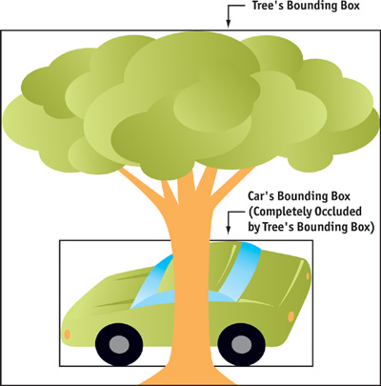
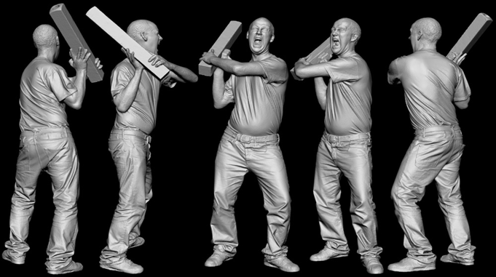
Challenges for Tracking
Occlusion
- It is a classic reseach problem in computer vision.
Different view points
(camera motion)
Notes:
Occlusion is the classic CV problem. It can cause serious problems in object detection and tracking.
View point invariance can further improve the tracking accuracy. As the quality of the image is improved.

Slide 4
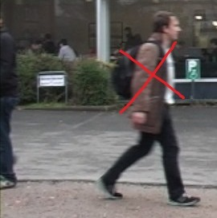
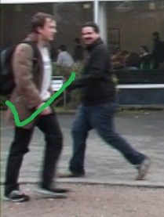
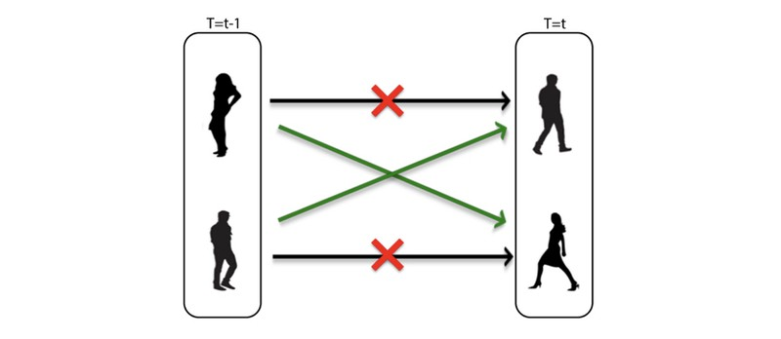
Challenges for Tracking
A varying number of targets
(birth/death of targets)
Data Association
Notes:
- Maintaining target‘s identity over time is challenging due to varying nr of targets in the frames.
Green tick shows the initiation of object in the scene and red cross shows the termination of objects from the scenes. The tracker‘s job is to correctly recognize the target as it re-enters the frame.
Data Association is one of the most important problem faced by trackers today. Assocation of 2 objects bounding boxes overtime.

Slide 5
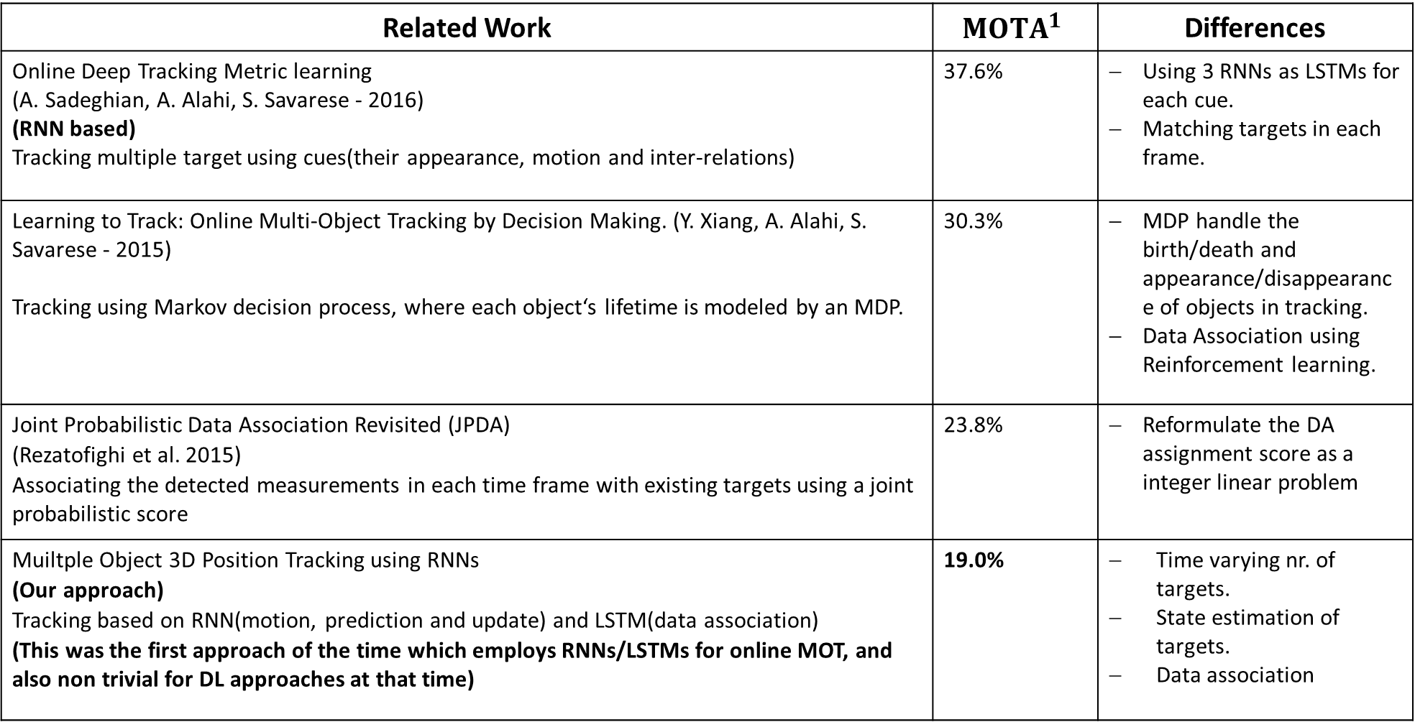
Related Work | $${MOTA}^{1}$$ | Differences
Online Deep Tracking Metric learning (A. Sadeghian, A. Alahi, S. Savarese - 2016) (RNN based) Tracking multiple target using cues(their appearance, motion and inter-relations) | 37.6% | Using 3 RNNs as LSTMs for each cue. Matching targets in each frame.
Learning to Track: Online Multi-Object Tracking by Decision Making. (Y. Xiang, A. Alahi, S. Savarese - 2015) Tracking using Markov decision process, where each object‘s lifetime is modeled by an MDP. | 30.3% | MDP handle the birth/death and appearance/disappearance of objects in tracking. Data Association using Reinforcement learning.
Joint Probabilistic Data Association Revisited (JPDA) (Rezatofighi et al. 2015) Associating the detected measurements in each time frame with existing targets using a joint probabilistic score | 23.8% | Reformulate the DA assignment score as a integer linear problem
Muiltple Object 3D Position Tracking using RNNs (Our approach) Tracking based on RNN(motion, prediction and update) and LSTM(data association) (This was the first approach of the time which employs RNNs/LSTMs for online MOT, and also non trivial for DL approaches at that time) | 19.0% | Time varying nr. of targets. State estimation of targets. Data association
1. Multiple-Object tracking Accuracy

Slide 6
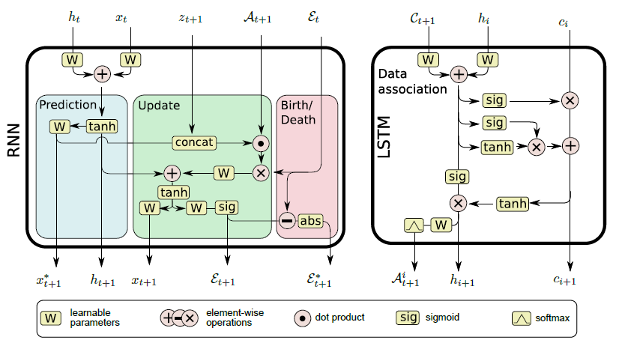
Architecture
Notes:
Let me demonstrate
Referrence of the authors here.
… this is the baseline arch that im reimplementing.. In TF
This is the baseline architecture for the work that I am doing …
As you can see there it’s a 2 stage process. We have here 3 RNN states and an LSTM state. Lets look at the RNN state, there we have prediction state which take the gt BBs and it outputs the predicted BBs we need to pass these prediction to the update state next BUT first we need to run Our LSTM memory cell so that we can get an association matrix. After as a 3rd step we need to pass or predited BBs to the update state where we will match our predicted BBs with the detections(measurements) we need to pass this association matrix to update state so that we can the updated target Obj with Updated BBs

Slide 7
RNN Stage - Prediction Layer
Using available ground truth Bboxes from current and the previous state. Predicting the target motion in the absence of the measurements.
Notes:
At prediction stage, the layer predicts BB in the 2nd frame for all the BB in the 1st frame.
The predicted bounding boxes have ids assigned to them.
In the next steps the model will associate predictions with detections (measurements).

Slide 8
RNN Stage – Update Layer
Updating the state for the target ‘x’ by updating the current status of the targets Bbox coordinates by introducing the measurements data ‘z’. Comparison between the measurement and target coordinates.
Notes:
Update layer requires the association matrix between detections and predictions. To update the state of the network.

Slide 9
RNN Stage – Birth/Death Layer
Targets can appear or disappear from a frame. Preserving target’s identity and association. Identifying target’s track initiation and termination.
Notes:
Association matrix tells which boxes need to be added and which boxes needs to be terminated.

Slide 10
LSTM Stage
Performing data association. Creating the asscociation matrix ‘A’ using the LSTM cell. Using to ‘A’ matrix to preserve the context and identity of a target over time.

Slide 11
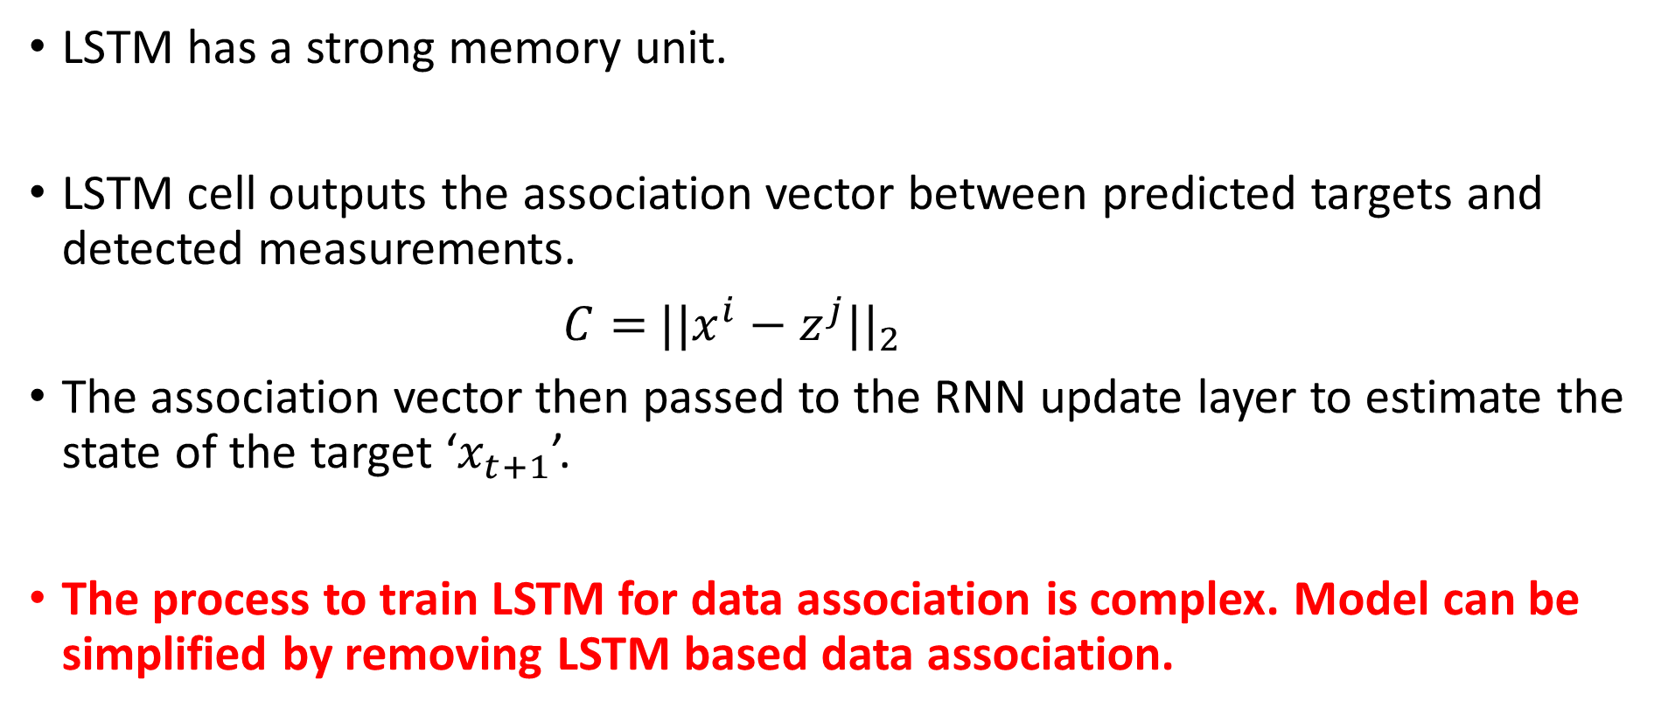
Data Association using LSTM
LSTM has a strong memory unit.
LSTM cell outputs the association vector between predicted targets and detected measurements.
$C=$ ${||x^{i}−z^{j}||}_{2}$
The association vector then passed to the RNN update layer to estimate the state of the target ‘$x_{t+1}$’.
The process to train LSTM for data association is complex. Model can be simplified by removing LSTM based data association.

Slide 12
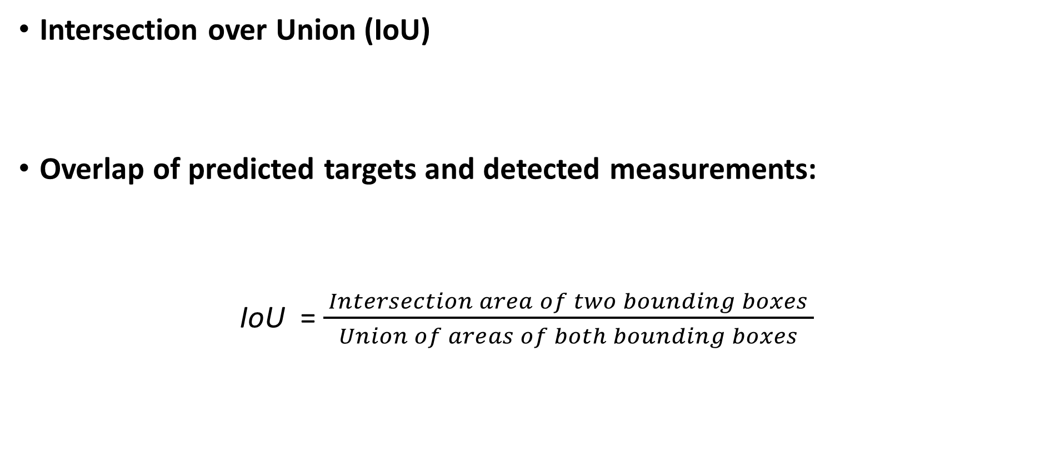
Data Association - Alternative approach
Intersection over Union (IoU)
Overlap of predicted targets and detected measurements:
IoU =$\frac{ Intersection area of two bounding boxes }{Union of areas of both bounding boxes}$

Slide 13
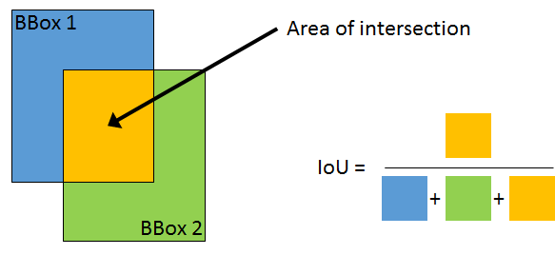
Data Association - Alternative approach
Finding similarities between
Bounding boxes.
Notes:
Checking the similarities of the 2 bounding boxes by overlapping them, a full overlap is perfect match.
Higher the IOU value means more similar the 2 BBs are to each other.

Slide 14
Experiment
Training Data
- Data with sequence of images is hard to get.
- MOTChallenge 2015 is used with 22 video sequences.
Implementation:
- Keras-Tensorflow
- The orignal paper paper was inspired by Andrea Karpathy RNN algorithm for textual data.

Slide 15

Evaluation Metrics
Two standard metrics:
MOTA
$$1 −\frac{\sum_{t}{(m_{t}+f_{pt}+mme_{t}) }}{\sum_{t}{g_{t}}}$$
MOTP
$$\frac{\sum_{i,t}{d_{i,t}}}{\sum_{t}{c_{t}}}$$
Notes:
Following are the evaluation metrics used for object tracking. They determine the tracker’s performance.
The MOTA for a perfect system is 1.
mt = nr of misses are we have a person(object) but without a BB.
FP = BB hai but person(object) nahi
mmet= Mismatch is the error in association.
We have to associate prediction with the detection

Slide 16
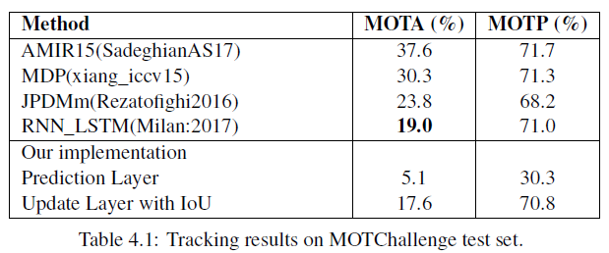
Results

Slide 17
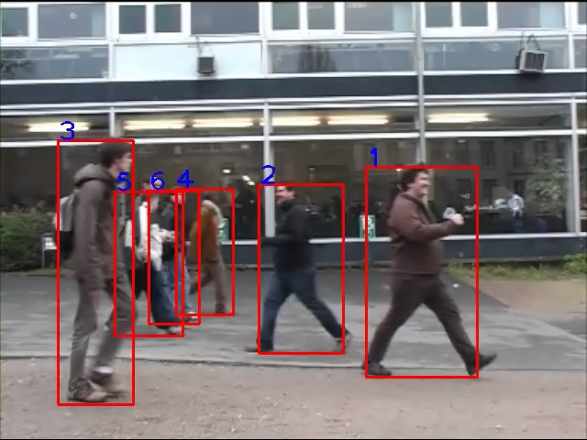
Demonstration

Slide 18
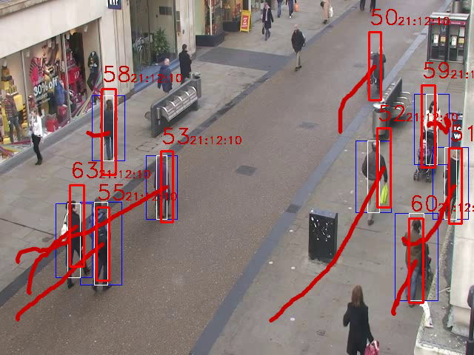
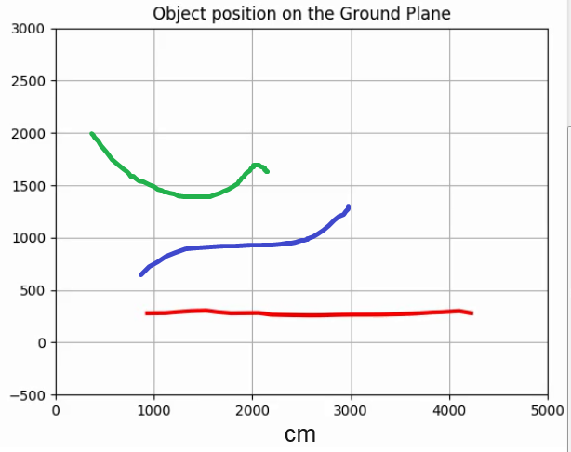
Next steps Conversion (2D -> 3D)

Slide 19
Thank you for the attention

